Slide 1
Capstone Progress

Slide 2
Simulation system
edge.py
Load image and pre-trained model
-> image preprocessing (resize, split, and tokenizer)
-> vision encoder
-> projected visual embeddings
-> send embeddings to cloud (HTTP API + json)
cloud.py
receive projected visual embeddings
-> rebuild tensor
-> tokenize text prompt
-> convert prompt tokens to text embeddings
-> concatenate visual embeddings + text embeddings
-> Generate ids
language decoder
-> lm head
-> generated text answer

Slide 3
Edge Device
Cloud Server
Input Image
Generate Output Text
Visual Encoder
LLM Decoder
Projection Module
Multimodal Input Construction
(Visual Embeddings + Text Prompt)
Intermediate Visual Embeddings
Secure Transport Channel
Received Visual Embeddings
Secure Session Establishment (Key Exchange)
Secure Session Establishment (Key Exchange)
Trusted Execution Environment
Notes:
BERT score

Slide 4
Edge Device
Cloud Server
Input Image
Generate Output Text
Visual Encoder
LLM Decoder
Projection Module
Multimodal Input Construction
(Visual Embeddings + Text Prompt)
Intermediate Visual Embeddings
Secure Transport Channel
Received Visual Embeddings
Secure Session Establishment (Key Exchange)
Secure Session Establishment (Key Exchange)
Trusted Execution Environment
Notes:
BERT score

Slide 5
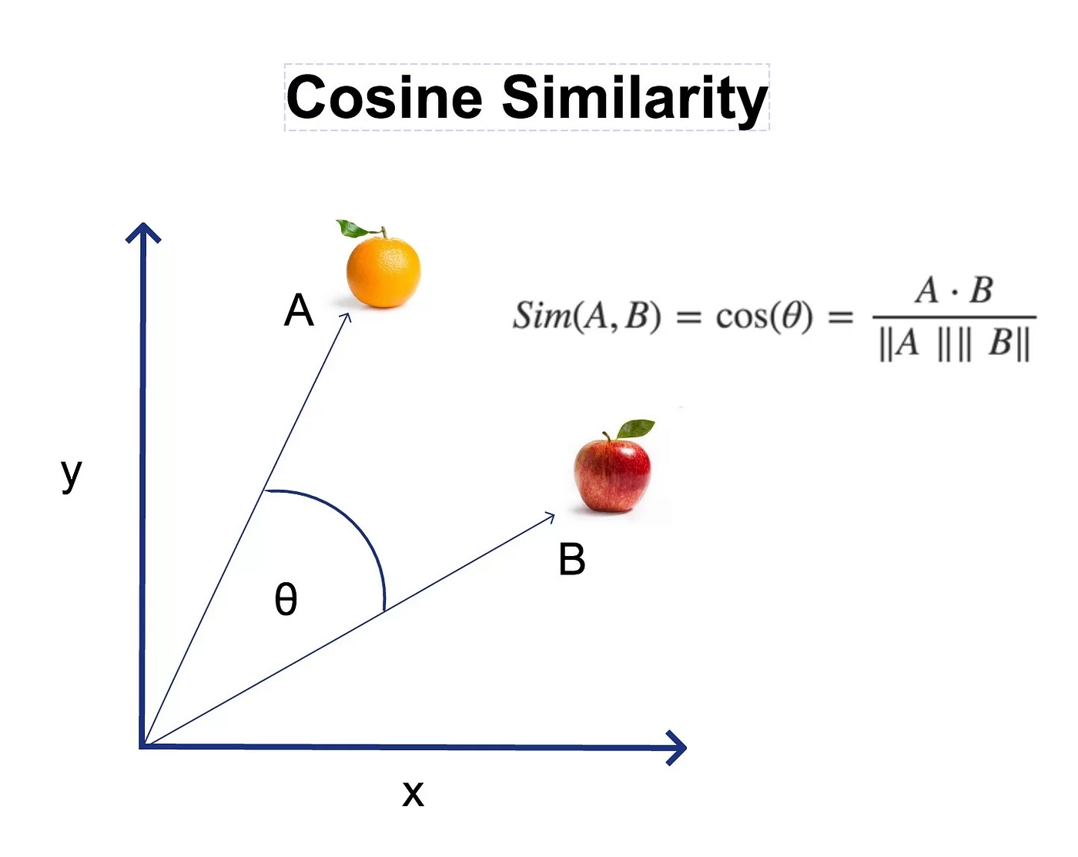
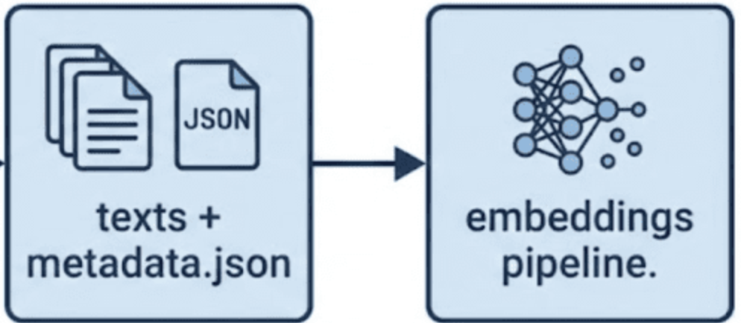



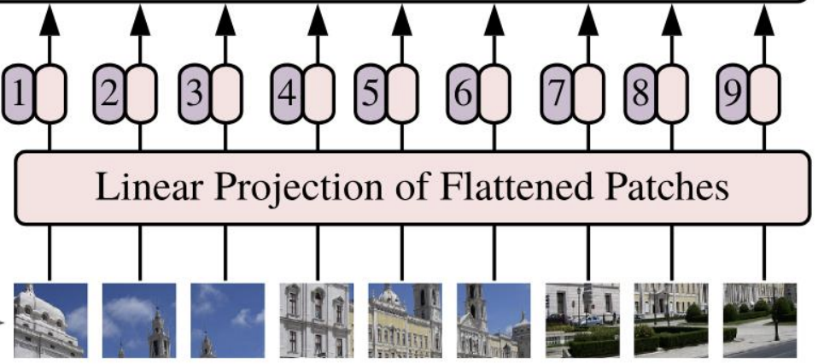



Cloud Service
Evaluation scripts
Reconstruct embedding
Output text
T1 | T2 | … | TN
Output text
Text Encoder
Output text
NanoVLM text
T1 | T2 | … | TN
NanoVLM text
NanoVLM text
Construct prompt
Generate text
Edge layer
Resize + Patch
Split + Position Embedding
Encypted data
Metadata + encoder
Image Dataset
+
Notes:
BERT score

Slide 6
Cloud Service
Evaluation scripts
Reconstruct embedding
Output text
T1 | T2 | … | TN
Output text
Text Encoder
Output text
NanoVLM text
T1 | T2 | … | TN
NanoVLM text
NanoVLM text
Construct prompt
Generate text
Edge layer
Resize + Patch
Split + Position Embedding
Encypted data
Metadata + encoder
Image Dataset
+
Notes:
BERT score

Slide 7
Edge layer
Visual Embedding Extraction
Original nanoVLM Inference
Resize + Patch
Split + Position Embedding
Image Dataset
Construct prompt
Generate text
Memory
Output Comparison
Cloud Service
Reconstruct embedding
Serialized Embeddings + Metadata
+
Network(Lo)
Construct prompt
Generate text
Notes:
BERT score

Slide 8
Literature Review
Current Problem and constrain -- Survey
Privacy Preserving and Security
- Fine-tuning Phase – Encryption or FHE
- Inference Phase – split learning + Encryption + MAC
Authentication:
Security Machanism：
Encryption:
Authentication:
Protocol:

Slide 9
Current Industry Practice 1
Direct raw image transmission via REST/RPC API
Client / camera / in-vehicle system → JPEG/PNG image -> Base64 JSON or binary HTTPS POST -> cloud inference service → text output
Main idea:
The original image is directly uploaded to the cloud service.
This is the common design used by many cloud vision APIs.
The cloud performs image understanding, OCR, object detection, or captioning.
Payload format:
Base64 image inside JSON request，Multipart/form-data binary upload，application/octet-stream binary upload
Encryption: HTTPS / TLS protects data in transit
Authentication: API key，Bearer token / OAuth token, Service account / IAM credentials
Example:
Google Cloud Vision API
Azure Computer Vision
AWS Rekognition

Slide 10
Current Industry Practice 2
Indirect cloud-storage transmission (offline / asynchronous)
Client / edge device -> JPEG/PNG image -> HTTPS upload -> cloud storage bucket -> cloud function / inference service reads image -> model inference → text
Main idea:
The original image is uploaded to object storage first, Then, the inference service later reads the image from storage. This is useful for batch processing, asynchronous inference, and large image files.
Encryption: In transit: HTTPS / TLS, At rest: server-side encryption (SSE-S3, SSE-KMS, or Azure/GCP managed encryption)
Authentication: Pre-signed URL (IAM role / service account), OAuth token, Access key / SAS token, depending on the cloud provider
For instance:
AWS S3 + Lambda + Rekognition / custom model
Google Cloud Storage + Cloud Functions + Vision API
Azure Blob Storage + Azure Functions + Computer Vision

Slide 11
Current Industry Practice 3
MQTT / IoT message broker transmission
Camera / IoT device → JPEG frame → MQTT binary payload or Base64 payload → broker → cloud function / inference service → text
Main idea:
Encryption : MQTT does not normally encrypt messages by itself. In real systems, MQTT is secured by running it over TLS/SSL (hardware support for AES is not commonly for embedded, ChaCha20 is a faster option)
Authentication: MQTT CONNECT packets can include User Name and Password fields. The broker can use these fields to authenticate the client. The MQTT 5.0 specification says implementations can use these fields directly, connect them to external authentication systems such as LDAP or OAuth, or use operating-system authentication.
Source: https://docs.oasis-open.org/mqtt/mqtt/v5.0/cos02/mqtt-v5.0-cos02
Used in : in-vehicle system

Slide 12
Literature review (basic idea)
Image transmission protection methods are relevant background.
Embedding transmission reduces raw-image exposure, but embeddings are still sensitive. (background)
Narrow down to embedding encryption and authentication combinations (find research gap)

Slide 13
Image transmission protection methods are relevant background
IOT Device Encyption and Authentication:
Embedded Systems Authentication and Encryption Using Strong PUF Modeling - Introducing that embedded devices face several security and performance limitations. (embedded encryption)
ChaCha20-Poly1305 authenticated encryption for high-speed embedded IoT applications (related to MQTT protocol)
Lightweight Internet of Things Device Authentication, Encryption, and Key Distribution Using End-to-End Neural Cryptosystems
Image Encryption:
A Lightweight Image Encryption Algorithm Based on Secure Key Generation (based on AES)
Transmission protocol: MQTT (classic protocol), what else?
Notes:
Embedded Systems Authentication and Encryption Using Strong PUF Modeling
https://ieeexplore.ieee.org/abstract/document/9043104?casa_token=TzGmEqi4czcAAAAA:FP9-Idn1xMF5z_j2kDuLO-pOOLk1aUnqQG75sw8GjfFpAKonMz5raTOEofeSaK4YYtV8hXbb
server-side authentication
client-side authentication – lack of computational resources.
ChaCha20-Poly1305 authenticated encryption for high-speed embedded IoT applications
https://ieeexplore.ieee.org/document/7927078
Authenticated Encryption Schemes: A Systematic Review
https://ieeexplore.ieee.org/abstract/document/9695453
A Lightweight Image Encryption Algorithm Based on Secure Key Generation (based on AES)
https://ieeexplore.ieee.org/document/10596034
1. Secure key generation
2. Dynamic S-box generation
3. Replace MixColumns with circular permutation

Slide 14
Embedding transmission reduces raw-image exposure, but embeddings are still sensitive. (background)
Understanding deep image representations by inverting them -- Inverts image representations to reconstruct visual content. This shown that, under white-box or partially known model settings, visual representations can be inverted to recover information about the original image.
Deep-BMI: Exploring Model Inversion Attacks in the Black-box Setting -- Black-box model inversion can reconstruct semantically meaningful images without accessing target model parameters, although it usually requires repeated queries to the target model.
Deep Learning Model Inversion Attacks and Defenses: A Comprehensive Survey -- how attackers can reconstruct private training data or sensitive information from deep learning models, and summarises existing defense methods.
Notes:
Deep Learning Model Inversion Attacks and Defenses: A Comprehensive Survey
https://arxiv.org/html/2501.18934v1
Exploring Model Inversion Attacks in the Black-box Setting
https://petsymposium.org/popets/2023/popets-2023-0012.pdf
Understanding deep image representations by inverting them
https://ieeexplore.ieee.org/document/7299155

Slide 15
Embedding encryption and authentication combinations
A privacy preserving split learning framework with adaptive inference selection for IoT security -- Split Learning, Gaussian noise-based DP, pruning, quantization, TensorFlow Lite, and adaptive model selection.
A privacy-preserving multi-user retrieval system for multimodal artificial intelligence
This paper shows that embedding transmission alone is not enough for privacy protection, so the authors combine embedding obfuscation, encryption, and secure key management for multimodal retrieval.
Notes:
A privacy preserving split learning framework with adaptive inference selection for IoT security
Key words:
Data privacy, cloud security

Slide 16
Research Gap (basic idea)
Evaluation: Existing secure transmission schemes may provide confidentiality and authentication, but their runtime overhead on edge devices remains an important factor for real-time image or embedding transmission.
Metrics : CPU usage, memory usage, end-to-end latency, payload size, throughput.
Other Metrics: encryption time, decryption time, key setup/exchange time

